Slide 1



Cafe Management System: Streamlining Operations
Simplify your cafe operations with an efficient management system that enhances customer experience and optimizes productivity.

Slide 2

Problem Statement:
Our idea was to come up with a smart cafe management system, which would make lives easier. The cafe management system should be able to provide the menu, take orders , show the availability of telescopes for stargazing and other special facilities of the cafe. It should also get feedback from the user. This cafe management system in short should streamline all the work and make the work efficient and effortless

Slide 3

The Need for a Cafe Management System
1
Seamless Ordering Process 📝
Eliminate order errors and reduce waiting time with an intuitive digital ordering system.
2
Inventory Management 📊
Efficiently track and manage your cafe's supplies, reducing waste and ensuring optimal stock levels.
3
Employee Efficiency ✨
Empower your staff with tools and analytics to streamline their tasks, improving service quality.

Slide 4
Key Features of our Cafe Management System
Menu details
Order review ,billing and feedback
Booking for stargazing
Borrowing books
Allow customers to choose their desired items in a fingertip, avoiding the problem of long queues.
Three telescopes available in the cafe can be booked in advance to enjoy the experience of star gazing at night.
Displays the available books to choose from, to have an enriching visit to our cafe.
Instant review of orders to avoid confusion and the total amount to be paid is displayed.

Slide 5
Programming concepts used:
Structures: The code defines several structures, such as MenuItem, Order, TelescopeBooking, and LibraryBook, to organize and represent data in a structured manner.
Functions: The code uses functions to encapsulate specific actions or operations. Functions like displayMenu, takeOrder, bookTelescope, displayOrder, displayLibrary, and borrowBook serve different purposes within the program.
Arrays: Arrays are used to store and manage data, such as the menu array for menu items, the orders array for customer orders, the telescopes array for telescope bookings, and the library array for library books.
Looping statements :The code utilizes a do-while loop to repeatedly display the menu, take user input, and perform various actions based on the user's choice. This loop continues until the user chooses to exit.
Conditional Statements: Conditional statements, such as if and switch, are used to make decisions based on user input and to handle different scenarios, like ordering, viewing orders, booking telescopes, and borrowing library books.
Math Operations: Mathematical operations are used to calculate the total bill by multiplying the price of menu items by their quantities and summing them up.
.

Slide 6
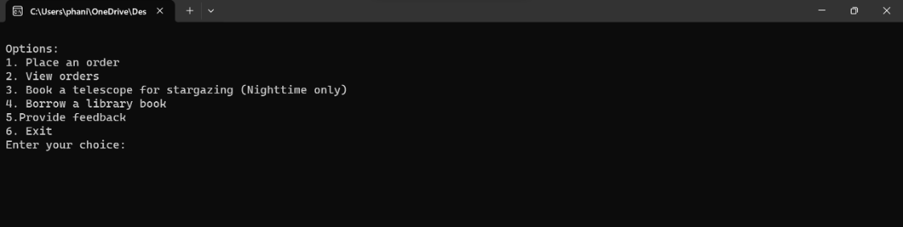
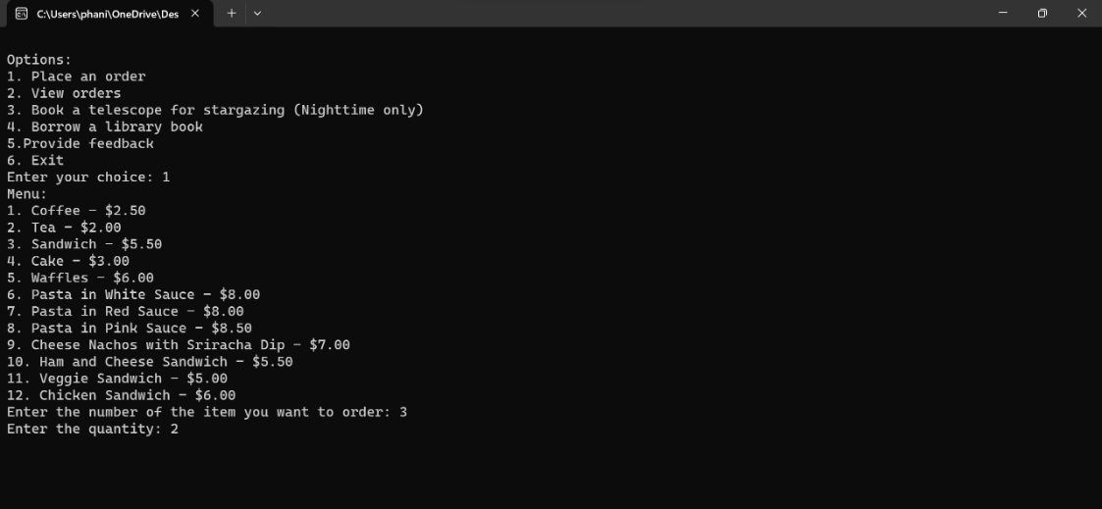
Outputs:

Slide 7
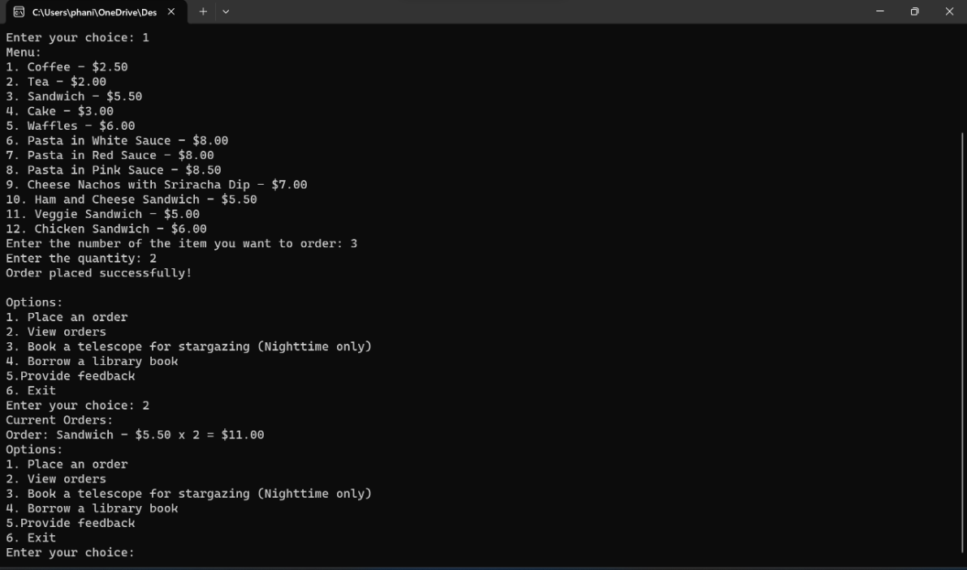

Slide 8
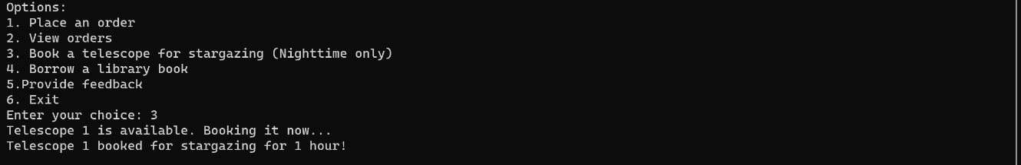
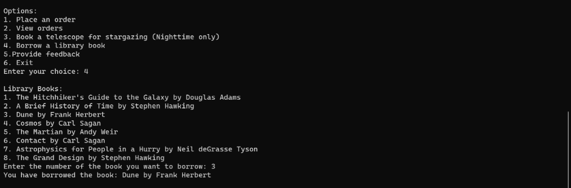
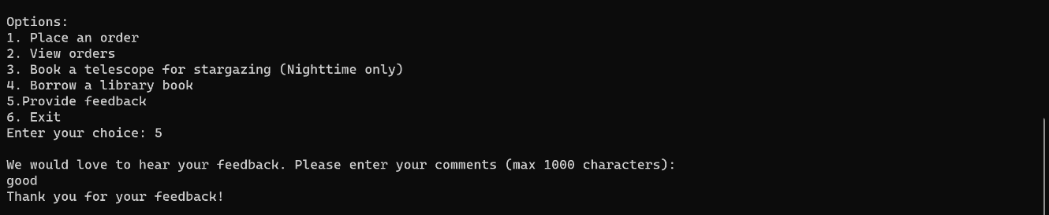

Slide 9
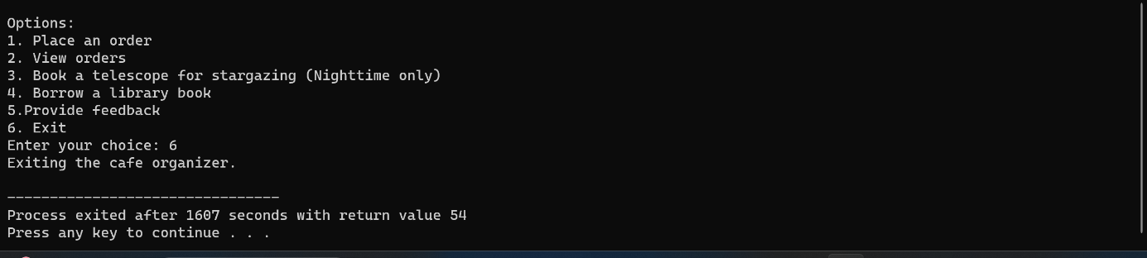

Slide 10
THANK YOU
By:
Swateekha
Phani Samhitha

